Slide 1
Relationship between greenhouse gases and temperature.
Ibrahim, Russell, Jessica, Opeyemi, Alecia
Notes:
RUSSELL

Slide 2
Purpose
As greenhouse gas emissions from human activities increase, they build up in the atmosphere and warm the climate.
Many of the major greenhouse gases stay in the atmosphere for tens to hundreds of years after being released.
The effects of these gases on the climate persist over a long time and can therefore affect both present and future generations.
Notes:
RUSSELL

Slide 3
Questions answered
What does the trend of greenhouse gas emission look like during the period of 1990-2013?
What does the trend look like for temperature by country for 1990-2013?
Does temperature change has a link with greenhouse gas in a specific geolocation?
Was there a rise in temperature when there was a spike in greenhouse gas emissions?
Notes:
RUSSELL

Slide 4
Content
What can audience get out of this presentation
Process of data cleaning
Analysis and finding of data
Findings and summary

Slide 5
Using this analysis..
The audience can get a better understanding of the temperature rise due to greenhouse gas emissions in the late 20th century and early 21st century up to 2013.
The audience will see a visual representation through 3D graphs of the relationship for Canada and Denmark.
Notes:
OPEYEMI/JESSICA

Slide 6
ETL Process: Datasets
Two datasets
Berkeley Earth Surface Temperature Study
This study has 1.6 billion temperature reports. We used a subset of data global land temperatures by country.
OECD greenhouse gas emission dataset
Organization for Economic Co-operation and Development (OECD) = international organization that fosters economic development/policy standards. 38 member countries.
Greenhouse gas emission by country for OECD countries only.
Notes:
OPEYEMI/JESSICA

Slide 7
ETL Process: Cleaning Data
Deleting excess columns in OECD data set.
Filtering out only countries in the Kaggle Berkeley Earth Data set to only include those in the OECD data set.
Normalizing Berkeley Earth temperature dataset country names to match those in OECD.
Aggregating Berkeley Earth temperature dataset for joins. (57 countries)
Notes:
ALECIA

Slide 8
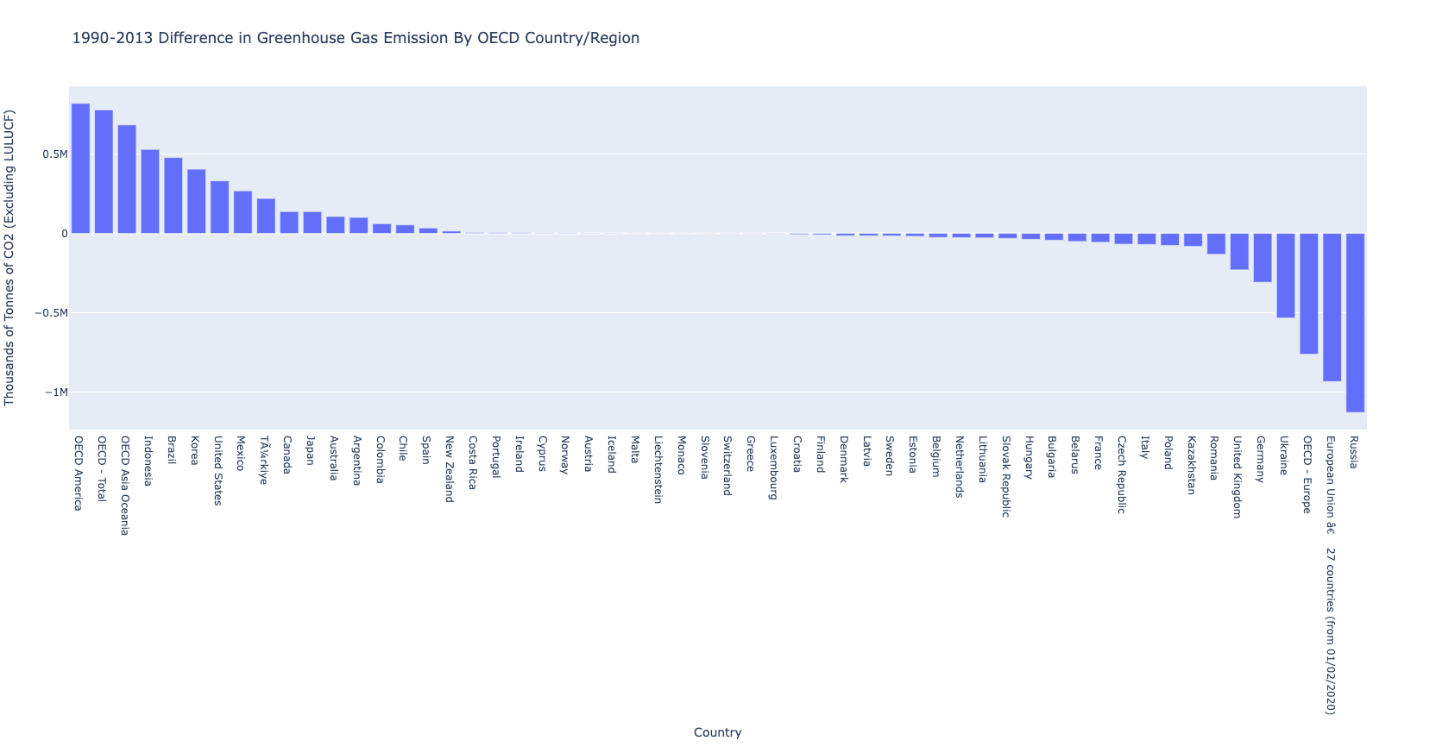
Greenhouse Gas Emissions Changes by Country
Differences is defined as Tonnes of CO2 from 1990 to 2013
Country with Greatest Increase: Indonesia*
Country with Greatest Decrease: Russia*
Notes:
ALECIA
*Note that these are only OECD countries and not all countries in the world are in this dataset.
Definitions -
OECD-Europe comprises all European members of the OECD (not necessarily EU members). In 2012 these were Austria, Belgium, Czech Republic, Denmark, Estonia, Finland, France, Germany, Greece, Hungary, Iceland, Ireland, Italy, Luxembourg, the Netherlands, Norway, Poland, Portugal, Slovak Republic, Slovenia, Spain, Sweden, Switzerland, Turkey and United Kingdom.

Slide 9
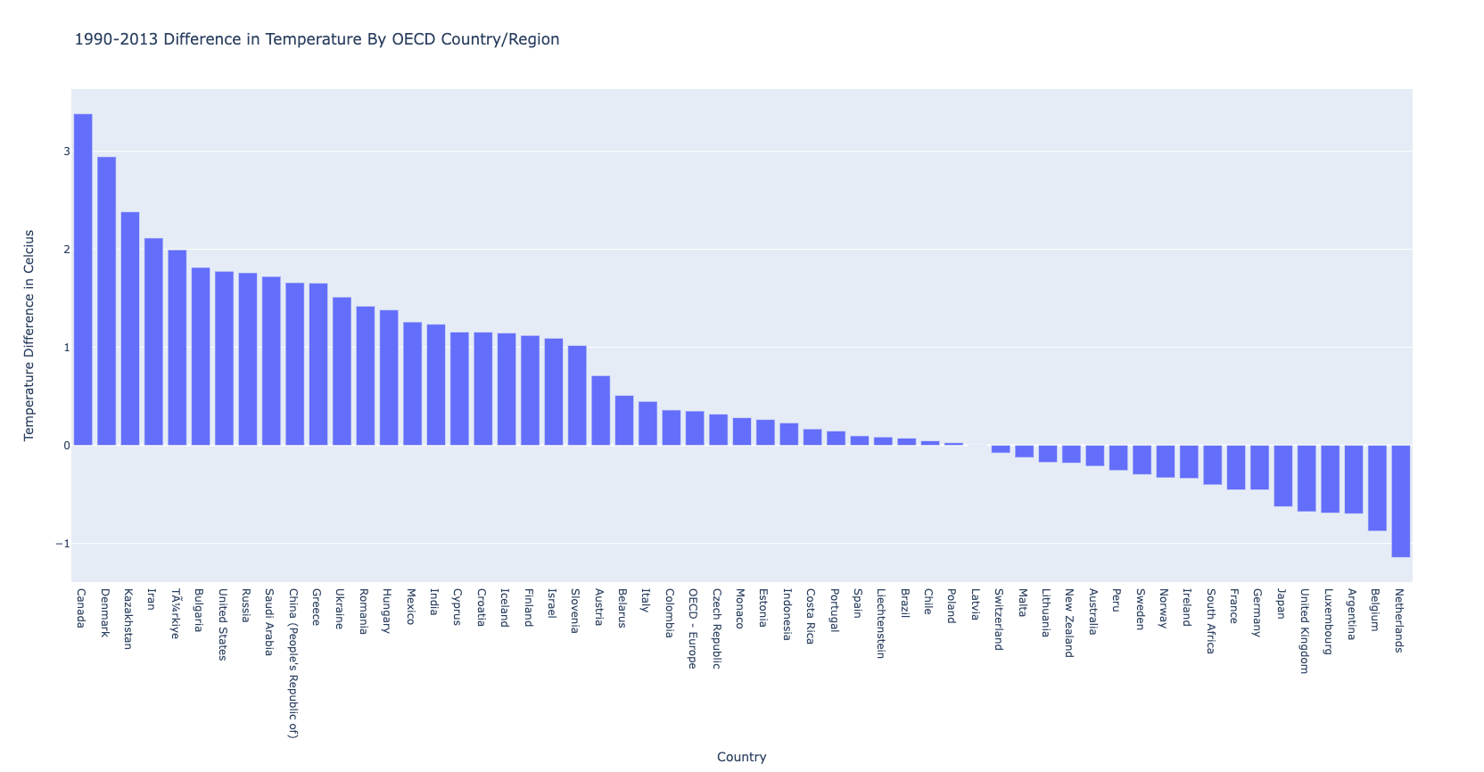
Temperature Changes by Country
Difference is defined as change in celsius from 1990 to 2013.
Country with Greatest Temperature Change: Canada
38 out of 57 had countries from this dataset displayed a temperature increase
Notes:
ALECIA

Slide 10
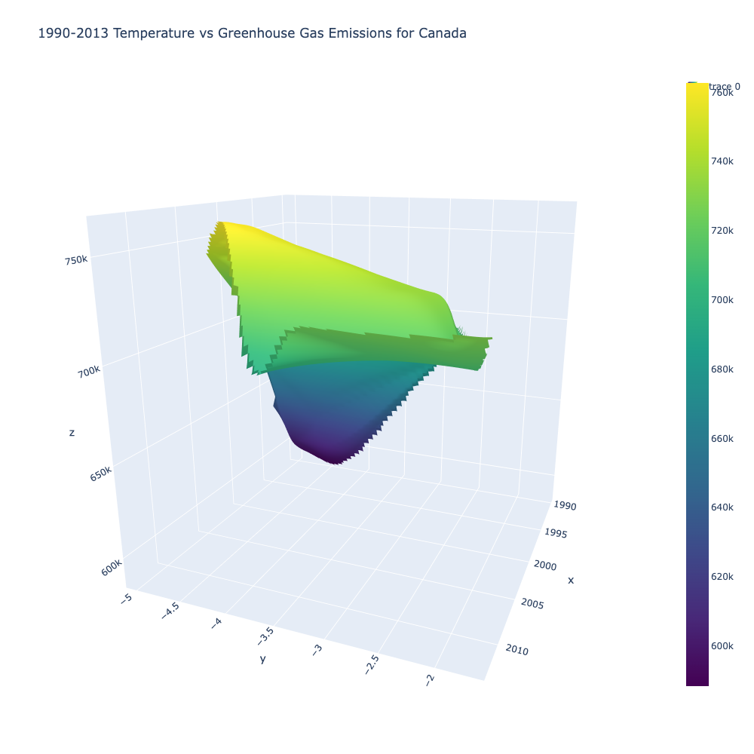
Analysis on Top 2: Canada
Rise in temperature overtime
Fluctuation in carbon emissions over the 24 year period.
Notes:
JESSICA

Slide 11
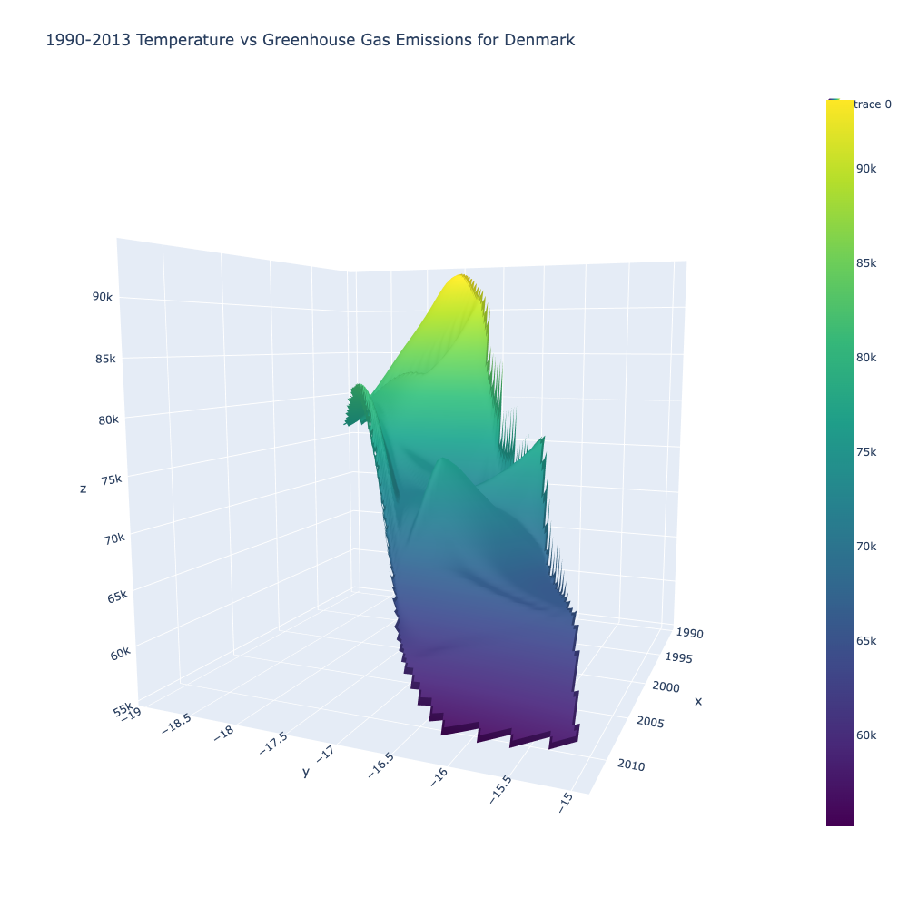
Analysis on Top 2: Denmark
Decrease over time in greenhouse gas emissions.
Rise in temperature over time.
Notes:
JESSICA temperature increase over time similar to other countries. Greenhouse gas emission decrease

Slide 12
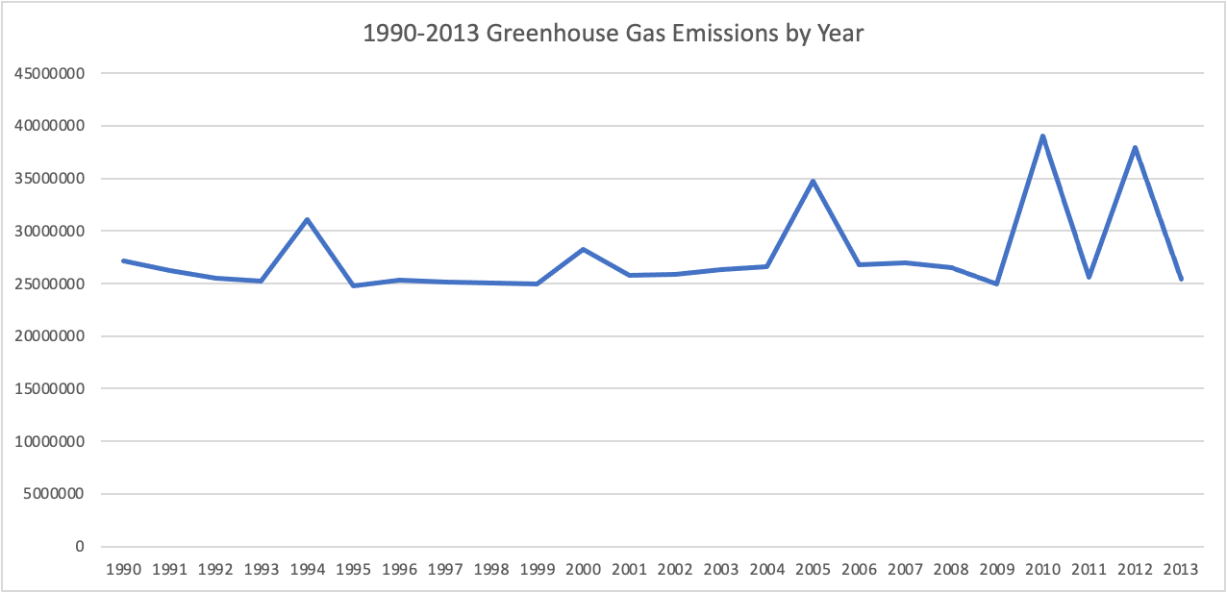
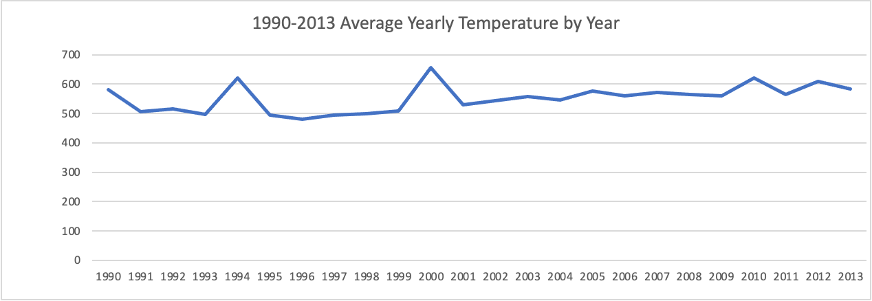
57 OECD Countries
Notes:
JESSICA

Slide 13
Overview on Analysis
Emission of greenhouse gasses is directly proportional to the temperature.
Decrease in greenhouse gas emissions in specific countries is not offsetting the overall increase in temperature for all OECD countries.
Notes:
IBRAHIM

Slide 14
Limitations and Future Considerations
Limitations:
Datasets only represent OECD countries (~30%) and is not representative of all in the world. There is limited amount of data for non-OECD countries.
Future Considerations:
Find a dataset with countries beyond OECD and years 2013-2022.
Datasets used are not representative of all of plant or global warming.
Review the population density and analyze per capita emissions by country.
Forecast the temperatures or emissions for future years.
Notes:
IBRAHIM

